Slide 1



SQL Final Project
IPL AUCTION OF 14TH SEASON 2021
Name:-Vikas Kumar
Gmail:-vikasdbg102@gmail.com
Internshala training-Data Science course
22/03/2024
1/22

Slide 2

CONTENTS
Create database, tables and import IPL-Ball & IPL-matches data’s
Bidding on batters
Aggressive batsman
Anchor batsman
Hard hitters
Bidding on bowlers
Economical bowlers
Wicket taking bowlers
Bidding on All rounders
Bidding for wicketkeeper
Additional questions for assessment
Explanations
Conclusion
22/03/2024
2/22

Slide 3

Create database, tables and import IPL-Ball & IPL-matches data's
Create table Deliveries and import data from IPL-Ball
create table Deliveries(id int, inning int, over int, ball int, batsman varchar, non_striker varchar, bowler varchar, batsman_runs int, extra_runs int, total_runs int, is_wicket int, dismissal_kind varchar, player_dismissed varchar, fielder varchar, extras_type varchar, batting_team varchar, bowling_team varchar);
copy Deliveries from 'C:\Program Files\PostgreSQL\16\data\data_copy\IPL_Ball.csv' delimiter ',' csv header;
Create table Matches and import data from IPL-matches
create table Matches(id int, city varchar, date varchar, player_of_match varchar, venue varchar, neutral_venue int, team1 varchar, team2 varchar, toss_winner varchar, toss_decision varchar, winner varchar, result varchar, result_margin int, eliminator varchar, method varchar, umpire1 varchar, umpire2 varchar);
copy Matches from 'C:\Program Files\PostgreSQL\16\data\data_copy\IPL_matches.csv' delimiter ',' csv header;
22/03/2024
3/22

Slide 4

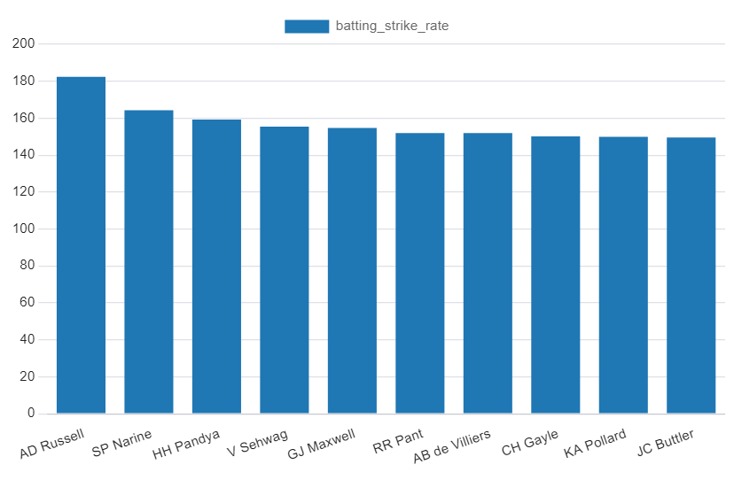
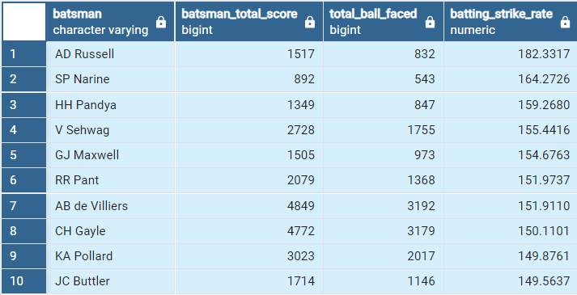
Bidding on batters
Bidding on Aggressive batsman
select batsman, batsman_total_score, total_ball_faced, round(cast(batsman_total_score as decimal)/cast(total_ball_faced as decimal)*100, 4) AS batting_strike_rate from (select batsman, sum(batsman_runs) as batsman_total_score, count(ball) as total_ball_faced from Deliveries where extras_type not in('wides') group by batsman) as subquery where total_ball_faced>=500 order by batting_strike_rate desc limit 10;
22/03/2024
4/22

Slide 5
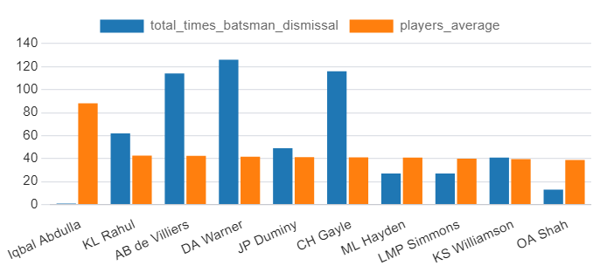
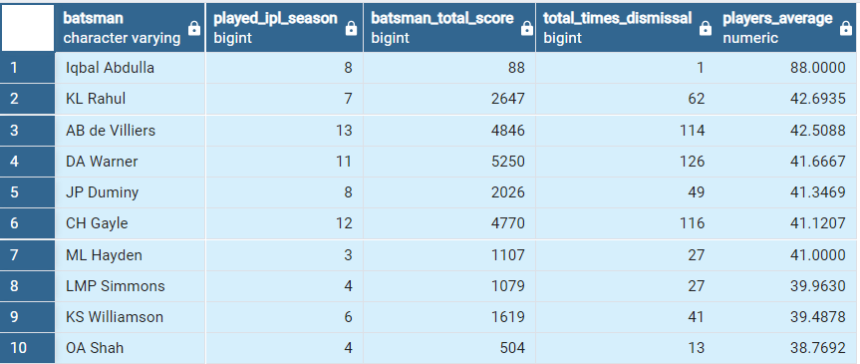
Bidding on batters continues….
Bidding on anchor batsman
select batsman, played_IPL_season, batsman_total_score, total_times_dismissal, round(cast(batsman_total_score as decimal)/cast(total_times_dismissal as decimal),4) AS players_average from (select batsman, count(distinct substring(date from 7 for 4)) as played_IPL_season, sum(case when dismissal_kind in ('NA') then batsman_runs else 0 end) as batsman_total_score, count(case when dismissal_kind not in ('NA') then is_wicket end) as total_times_dismissal from (select a.*, b.date from Deliveries as a left join Matches as b on a.id=b.id) group by batsman) as subquery where total_times_dismissal>=1 and played_IPL_season>2 order by players_average desc limit 10;
22/03/2024
5/22

Slide 6
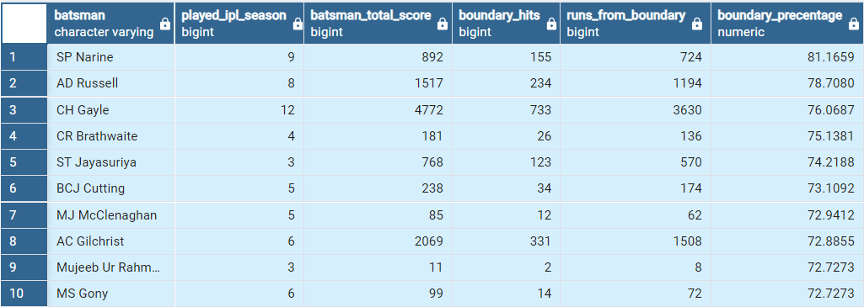
Bidding on batters continues….
select batsman, played_IPL_season, batsman_total_score, boundary_hits, runs_from_boundary, round(cast(runs_from_boundary as decimal)/cast(batsman_total_score as decimal)*100, 4) AS boundary_percentage from (select batsman, count(distinct substring(date from 7 for 4)) as played_IPL_season, sum(batsman_runs) as batsman_total_score, count(case when batsman_runs in (4,6) then batsman_runs end) as boundary_hits, sum(case when batsman_runs in (4,6) then batsman_runs else 0 end) as runs_from_boundary from (select a.*, b.date from Deliveries as a left join Matches as b on a.id=b.id) group by batsman) as subquery where played_IPL_season>2 order by boundary_precentage desc limit 10;
Bidding on hard hitters
22/03/2024
6/22

Slide 7
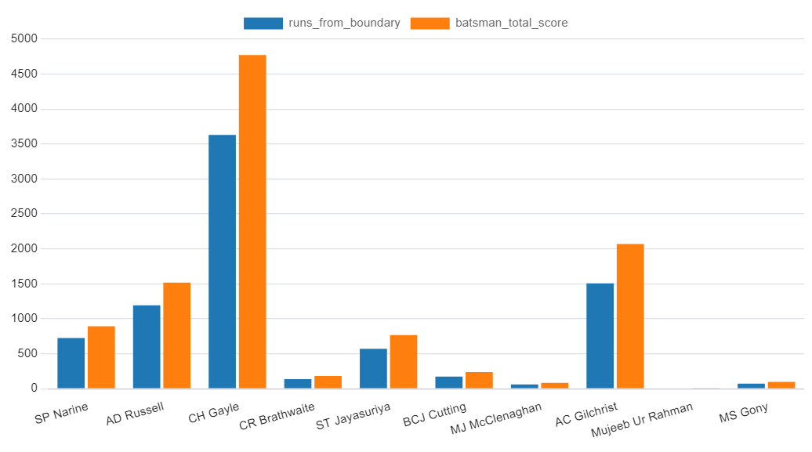
Bidding on batters continues….
Bidding on hard hitters continues….
22/03/2024
7/22

Slide 8

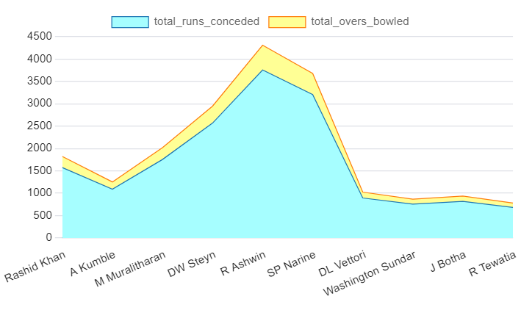
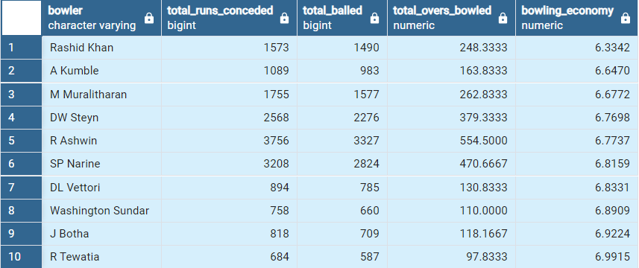
Bidding on bowlers
select bowler, total_runs_conceded, total_balled, total_overs_bowled, round(cast(total_runs_conceded as decimal)/cast(total_overs_bowled as decimal), 4) AS bowling_economy from (select bowler, sum(total_runs) as total_runs_conceded, count(ball) as total_balled, round(cast(count(over) as decimal)/6, 4) as total_overs_bowled from Deliveries group by bowler) as subquery where total_balled>=500 order by bowling_economy asc limit 10;
Bidding on Economical bowlers
22/03/2024
8/22

Slide 9
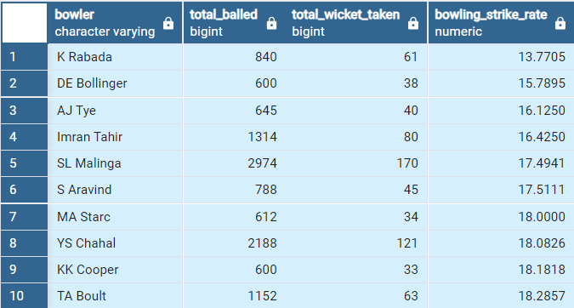
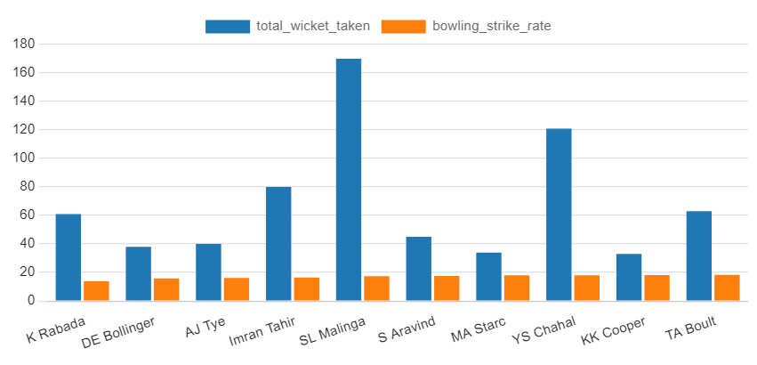
Bidding on bowlers continues….
Bidding on Economical bowlers
select bowler, total_balled, total_wicket_taken, round(cast(total_balled as decimal)/cast(total_wicket_taken as decimal), 4) AS bowling_strike_rate from (select bowler, count(ball) as total_balled, count(case when dismissal_kind not in ('NA', 'run out') then dismissal_kind end) as total_wicket_taken from Deliveries group by bowler) as subquery where total_balled>=500 order by bowling_strike_rate asc limit 10;
22/03/2024
9/22

Slide 10

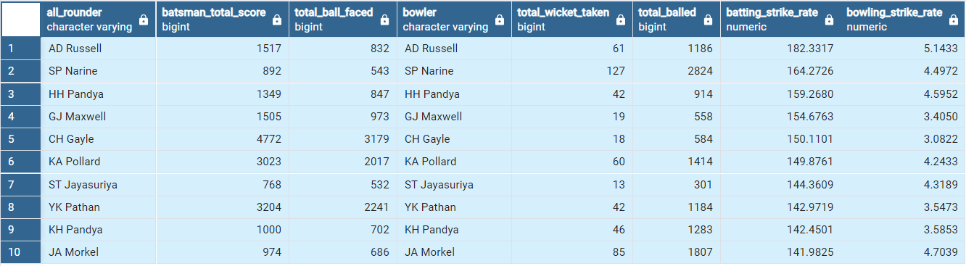
Bidding on All-rounders
with batting_stats as (select batsman, batsman_total_score, total_ball_faced from (select batsman, sum(batsman_runs) as batsman_total_score, count(ball) as total_ball_faced from Deliveries where extras_type not in('wides') group by batsman) as subquery where total_ball_faced>=500), bowling_stats as (select bowler, total_balled, total_wicket_taken from (select bowler, count(ball) as total_balled, count(case when dismissal_kind not in ('NA','run out') then dismissal_kind end) as total_wicket_taken from Deliveries group by bowler) as subquery where total_balled>=300) select a.batsman as all_rounder, a.batsman_total_score, a.total_ball_faced, b.bowler as bowler, b.total_wicket_taken, b.total_balled, round(cast(a.batsman_total_score as decimal)/cast(a.total_ball_faced as decimal)*100, 4) as batting_strike_rate, round(cast(b.total_wicket_taken as decimal)/cast(b.total_balled as decimal)*100, 4) as bowling_strike_rate from batting_stats a inner join bowling_stats b on a.batsman = b.bowler order by batting_strike_rate desc, bowling_strike_rate asc limit 10;
22/03/2024
10/22

Slide 11
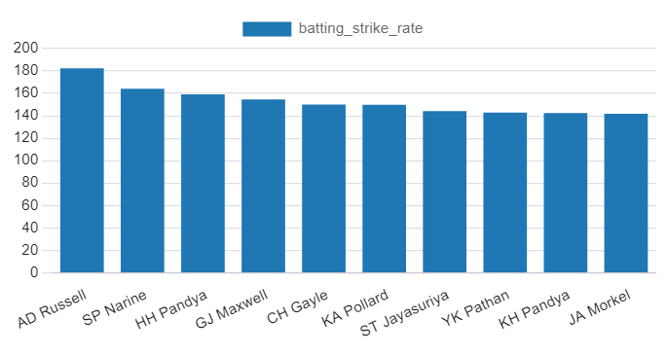
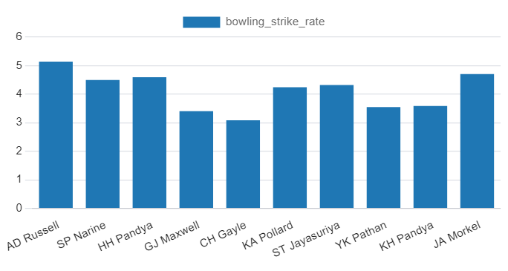
Bidding on All-rounders continues…
For batting strike rate and bowling strike rate, I multiply by 100 to get the actual form of strike rate figures.
Because of huge the difference in numeric values, I can't plot them on the same graph. So, I plotted separately for all-rounders with bowling and batting strike rates
22/03/2024
11/22

Slide 12
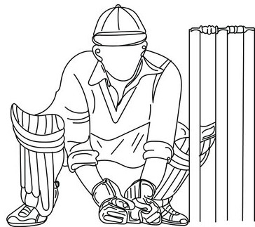
Bidding on wicket-keeper
I will ensure that in the list of wicketkeepers, bowlers' names are not listed because it can cause difficulties in wicketkeeping when they themselves are bowling.
A wicketkeeper with a good batting strike rate will be a valuable addition to the team.
I will extract the fielder names who fall under categories of dismissal-kind equal to 'catch' and 'run out', as it shows good fielder criteria.
If we have historical data of fall of wicket because of wicketkeepers with any dismissal-kind, then we will count the total falls of wicket for the same and target the highest wicketkeeper.
Sample code based on above criteria
select w.player_name as wicketkeeper_name,case when w.batting_strike_rate>(select avg(batting_strike_rate) from wicketkeepers) then 'Good Batting Strike Rate' else 'Regular Batting Strike Rate' end as batting_performance, count(f.fall_of_wicket) as total_falls_of_wicket from wicketkeepers w left join bowlers b on w.player_name=b.player_name join historical_data h on w.player_name = h.wicketkeeper_name join falls_of_wicket f on h.match_id = f.match_id where b.player_name is NULL and f.dismissal_kind in ('catch', 'run out') group by w.player_name order by total_falls_of_wicket desc limit 10;
22/03/2024
12/22

Slide 13



Additional questions for assessment
1. Count of cities hosted an IPL match
select count(distinct city) as cities_hosted_IPL_match from Matches;
2. Create table deliveries_v02
create table deliveries_v02 as (select *, case when total_runs>=4 then 'boundary' when total_runs=0 then 'dot' else 'other' end as ball_result from Deliveries);
3. Total number of boundaries and dot balls
create table deliveries_v02 as (select *, case when total_runs>=4 then 'boundary' when total_runs=0 then 'dot' else 'other' end as ball_result from Deliveries);
22/03/2024
13/22

Slide 14
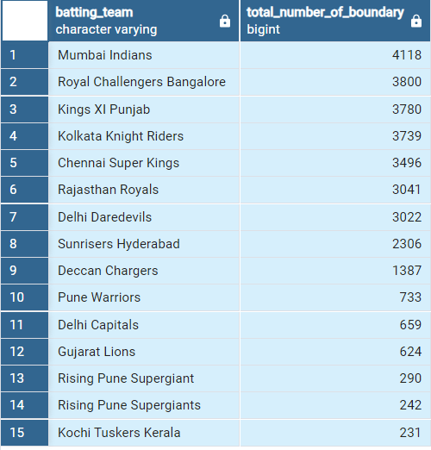
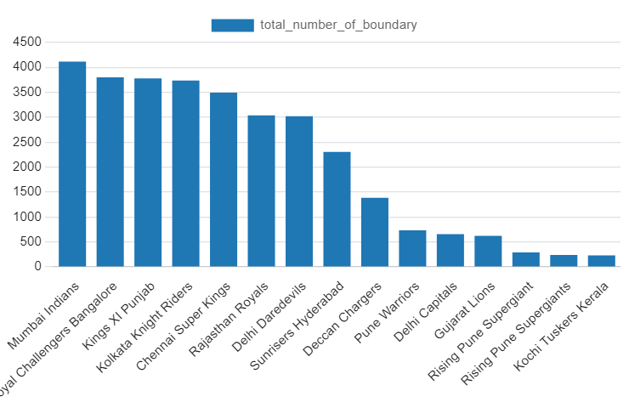
Additional questions for assessment continues….
4. Total number of boundaries scored by each team
select batting_team, count(case when ball_result in ('boundary') then ball_result end) as total_number_of_boundary from deliveries_v02 group by batting_team order by total_number_of_boundary desc;
22/03/2024
14/22

Slide 15
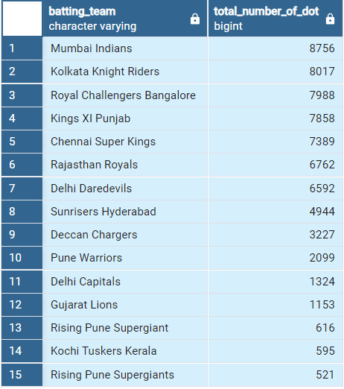
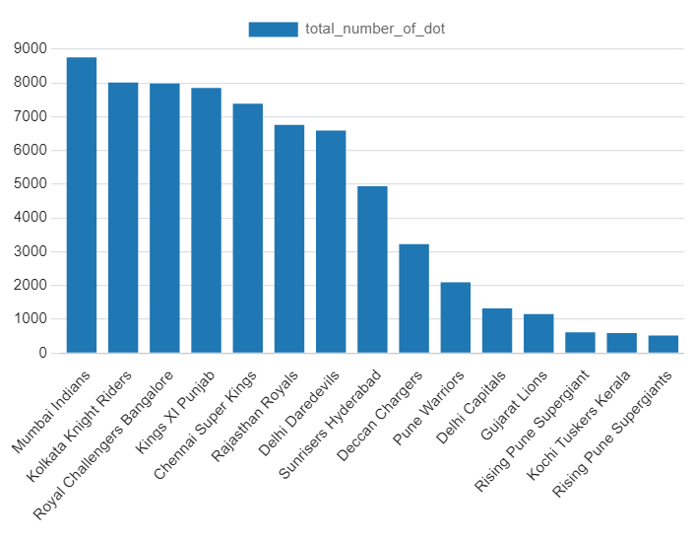
Additional questions for assessment continues….
5. Total number of dot balled by each team
select batting_team, count(case when ball_result in ('dot') then ball_result end) as total_number_of_dot from deliveries_v02 group by batting_team order by total_number_of_dot desc;
22/03/2024
15/22

Slide 16
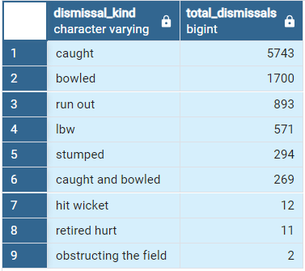
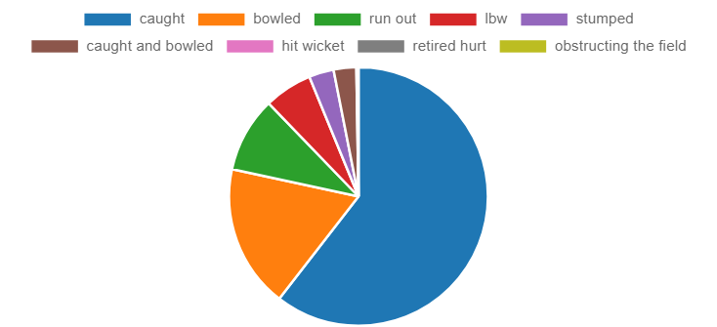
Additional questions for assessment continues….
6. Total number of dismissals for dismissal kind is not equal to “NA”
select dismissal_kind, count(*) as total_dismissals from deliveries_v03 where dismissal_kind not in('NA') group by dismissal_kind order by total_dismissals desc;
22/03/2024
16/22

Slide 17
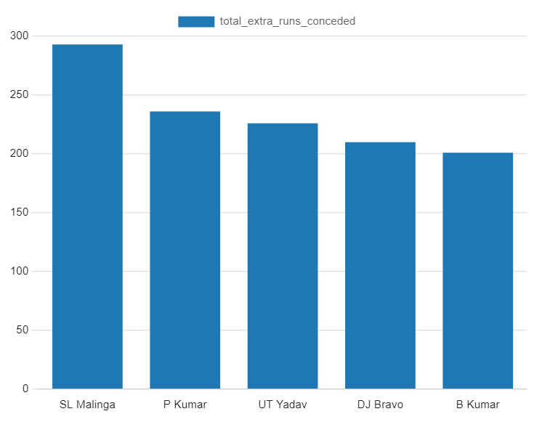
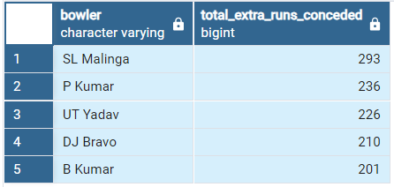
Additional questions for assessment continues….
7. Top 5 bowlers who conceded maximum extra runs
select bowler, sum(extra_runs) as total_extra_runs_conceded from Deliveries group by bowler order by total_extra_runs_conceded desc limit 5;
8. Create table deliveries_v03
create table deliveries_v03 as (select a.*, b.venue as venue, b.date as match_date from deliveries_v02 as a inner join Matches as b on a.id=b.id);
22/03/2024
17/22

Slide 18
Additional questions for assessment continues….
9. Total runs scored for each venue
select venue, count(total_runs) as venuewise_total_runs from deliveries_v03 group by venue order by venuewise_total_runs desc;
Sl no. | venue | venuewise_total_runs
1 | Eden Gardens | 17988
2 | Wankhede Stadium | 17584
3 | Feroz Shah Kotla | 17294
4 | Rajiv Gandhi International Stadium, Uppal | 15200
5 | M Chinnaswamy Stadium | 14895
6 | MA Chidambaram Stadium, Chepauk | 13881
7 | Sawai Mansingh Stadium | 11150
8 | Punjab Cricket Association Stadium, Mohali | 8266
9 | Dubai International Cricket Stadium | 8038
10 | Sheikh Zayed Stadium | 6906
11 | Maharashtra Cricket Association Stadium | 5055
12 | Punjab Cricket Association IS Bindra Stadium, Mohali | 5003
13 | Sharjah Cricket Stadium | 4317
14 | Subrata Roy Sahara Stadium | 4064
15 | Dr DY Patil Sports Academy | 3993
16 | Kingsmead | 3643
17 | M.Chinnaswamy Stadium | 3494
18 | Dr. Y.S. Rajasekhara Reddy ACA-VDCA Cricket Stadium | 3037
Sl no. | venue | venuewise_total_runs
19 | Sardar Patel Stadium, Motera | 2882
20 | SuperSport Park | 2866
21 | Brabourne Stadium | 2719
22 | Saurashtra Cricket Association Stadium | 2368
23 | Himachal Pradesh Cricket Association Stadium | 2159
24 | Holkar Cricket Stadium | 1965
25 | New Wanderers Stadium | 1940
26 | Barabati Stadium | 1695
27 | St George's Park | 1677
28 | JSCA International Stadium Complex | 1671
29 | Newlands | 1528
30 | Shaheed Veer Narayan Singh International Stadium | 1431
31 | Nehru Stadium | 1155
32 | Green Park | 921
33 | Vidarbha Cricket Association Stadium, Jamtha | 742
34 | De Beers Diamond Oval | 726
35 | Buffalo Park | 715
36 | OUTsurance Oval | 500
22/03/2024
18/22

Slide 19
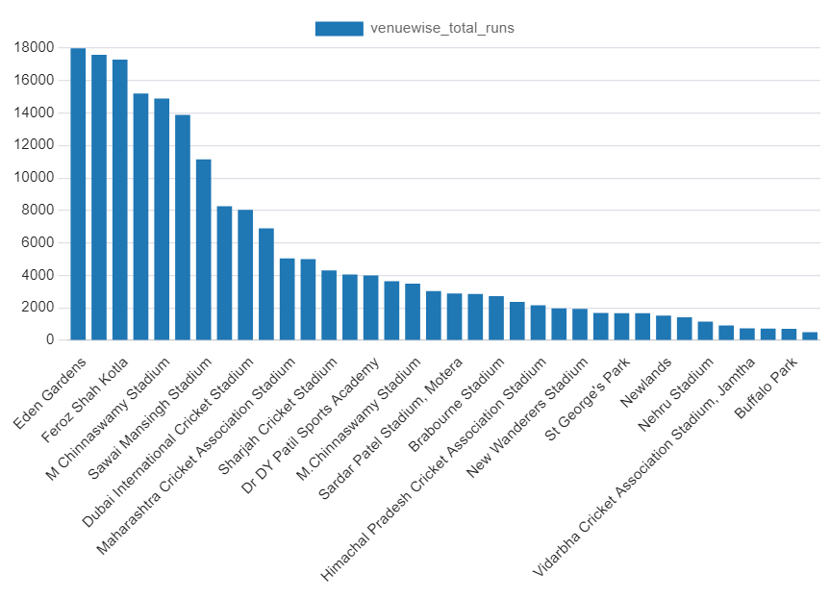
Additional questions for assessment continues….
9. Total runs scored for each venue continues….
22/03/2024
19/22

Slide 20
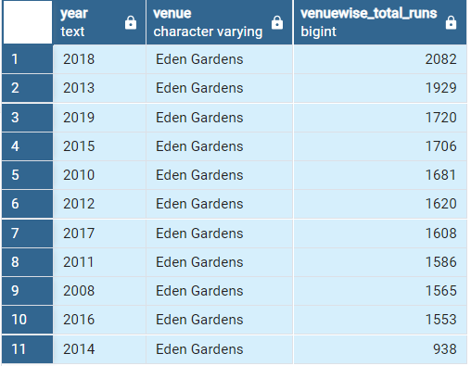
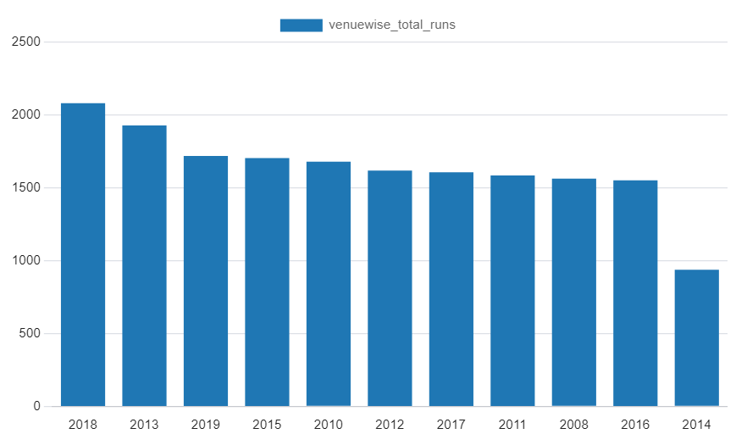
Additional questions for assessment continues….
10. Total runs scored for each venue continues….
select distinct substring(match_date from 7 for 4) as year, venue, count(total_runs) as venuewise_total_runs from deliveries_v03 where venue='Eden Gardens' group by year, venue order by venuewise_total_runs desc;
22/03/2024
20/22

Slide 21

Explanations
Instead of multiplying by 1.0 to get values in decimal, I used casting to round values up to 4 decimals.
In question-2, it's mentioned as wicket_ball (0,1). I understood that it's about selecting whether a wicket is taken or not. So, if I'm not mistaken, based on that column (is_wicket), I wrote a query to obtain the desired outputs.
For bidding on batters, bowlers, all-rounders, and for batting strike rate, bowling strike rate, and boundary percentage, I multiply by 100 to get the actual form of strike rate figures.
For the visualization, I used only the SQL platform because nowhere is it mentioned to use another platform. So, based on the limited options with visualization tools, I tried to extract meaningful charts/plots.
For bidding on wicketkeeper, I explained it on slide number 12.
For visualization, I attempted to extract meaningful charts for all questions and kept all the details, along with codes and output, in the same slide
22/03/2024
21/22

Slide 22


22/03/2024
22/22

